Slide 1
Mobile Graphics
March 15 2007

Slide 2
Intro
Computer graphics has been around for decades already with applications ranging from video gaming, user interfaces and scientific visualization.
The phrase ‘Mobile Computer Graphics’ can be interpreted in two ways: computer graphics on the go, and as graphics on a mobile computer.

Slide 3
Moore’s Law
Handheld devices becoming ubiquitous devices for both computation and communication.
In several countries cell phone subscriptions are more than number of people.
Computation speed increases roughly with the complexity of cost-effective circuits doubling every 1-2 years.
High end cell phone has more computational power than a late 1990’s home PC.
Display resolutions surpass NTSC TV standard with better color fidelity.

Slide 4
Third-party Applications
Until recently only manufacturers could install applications on phones.
Now, over a hundred million high-end smart phones that allow for installation of third-party native binary applications.
Further, a billion Java-enabled phones allow installation of portable bytecode applications with relatively uniform execution environment across all phones and manufacturers.

Slide 5
Use Cases for Mobile Graphics
Most common use is entertainment.
Other applications are user interfaces, maps, location-dependent tourist guides.

Slide 6
Mobile Graphics - Evolution
The first mobile phones were huge and heavy ‘bricks’ mostly used in cars and for analog radio networks.
In the late 1980’s and early 1990’s these devices became more portable.
Eventually, the got secondary applications like alarm clocks, text messaging.
Displays turned into dot matrices with simple games like Snake from Nokia.
Then came color displays, cameras, web browsers.
First mobile phone to support 3D graphics outside Japan was Nokia 3410 GSM phone in 2002.

Slide 7
Mobile Graphics Spectrum
Basic Phones
Feature Phones
Smart Phones
True mobile computers.
Key features include large, sharp and vivid displays, powerful processors, plenty of memory, multimedia and network capabilities.
Java usually supported.
Closed system with proprietary operating systems.
Can only develop applications if you work for the company.
Limited in processing power and screen resolution.
Represent the bulk of the market in developed countries with majority of them using Java.

Slide 8
Display Technology
Evolution of mobile phones coincided with that of digital cameras.
Digital cameras started demand for small, cost-efficient, low-power, high quality displays.
Now mobile phones incorporate digital cameras.
Most mobile devices come with color displays with 100-200 pixels per side with 16-24 bits of color depth.
High-end devices have resolutions from quarter-VGA and 24 bits color depth.
Main dilemma is physical size. N93 has TV-out option though.

Slide 9
Processing Power
While processing power of integrated circuits continue to increase (~40-60%) in line with Moore’s Law, battery capacity does not (only around 10%).
Mobile devices need to spare battery power to provide sufficient operating time and for low heat dissipation.

Slide 10
Graphics Hardware
The first generation of dedicated 3D graphics accelerators for handhelds is already available in smart phones.
Dedicated graphics processor (GPU) more power efficient than a general purpose CPU. (Eg: CPU may require a speed up of 20 times higher to achieve same rasterization performance).

Slide 11
Graphics Hardware
Power efficiency is key.
Chip itself does not consume a lot of power, but also when accessing external memory such as the framebuffer.
Hence rendering architectures that minimize traffic to and from external memory is important.
The graphics processor needs to be relatively cheap to keep the cost of the device down to appeal to majority of customers.

Slide 12
Native Execution Environments
Initially only native binaries could be integrated into the firmware of the device at build time.
The ability to download and execute native applications has been possible only recently.
Main reasons for this is device security.
Symbian, PalmOS, Windows Mobile address some of these issues.

Slide 13
The Java Platform
Nearly all mobile phones sold in developing countries today are equipped with Java Micro Edition (Java ME).
Most widely deployed platform.
Provides intrinsic security, fairly open vendor-neutral status, easier programming learning curve, vast number of tools, code and APIs.
However secure robust virtual machine architecture leads to reduced application performance and limited access to platform capabilities.

Slide 14
Fragmentation and Compatibility Issues
Fragmentation refers to several approaches to the same technical problem.
Large variety of proprietary content formats and tools increase cost of content creation and distribution.
However this is a natural evolution to technology.

Slide 15
2D Graphics
The MIDP profile offers 2D graphics functionality with basic drawing primitives such as lines, circles and polygons.
Suitable for 2D games and applications.
OpenVG part of the native application framework provides high-quality 2D vector graphics functions such as anti-aliased lines, curves and filled shapes.

Slide 16
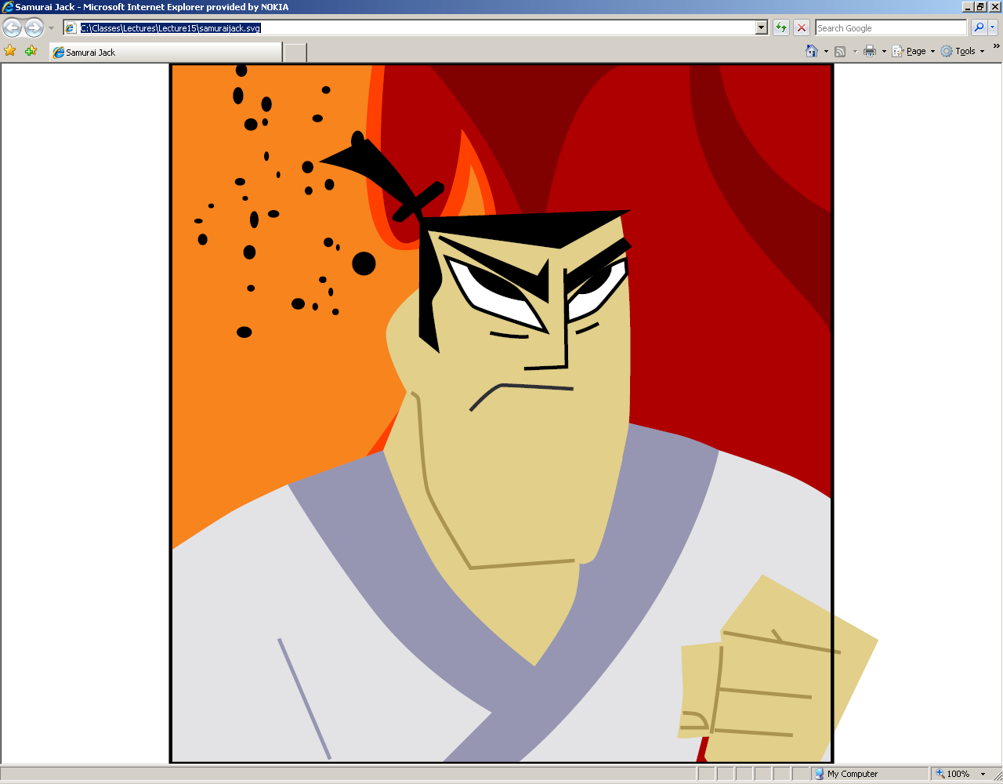

Slide 17
Class Project Discussion
Initial Ideas and Topics

Slide 18
Virtual Post-its Application
User approaches a large display to create new post-its for display. The post-its could be of various flavors such as a meeting appointment, note, etc.
You can request post-its by name, date, contacts, etc.
Post-its display on phone based on flavor.
You can also leave a note either as a new one or a follow-up to an existing one.

Slide 19
Geo-tagging Application
Any kind of sharing and viewing data application leveraging location information.
One example would be peer-to-peer image sharing by using token exchange that is valid only at that location.

Slide 20
Mobile Advertising
Based on user interests, location, etc. create target ads to the user that appear relevantly.

Slide 21
Bar-Code Application
Any application using barcodes to tag
to specific products, inventory management.
You would have to find a barcode scanner
software that interfaces with your phone.
Check out:
http://people.inf.ethz.ch/adelmanr/batoo/index.php

Slide 22
Intelligent Media Downloader
Based on network bandwidth, can one come up with intelligent ways of downloading information?
For example, for a webpage, I might want to download only the most important elements first and then slowly refine the page.

Slide 23
OCR Application
Applications that leverage Optical Character Recognition (OCR).
For J2ME software, refer to:
http://www.seeingwithsound.com/midlet.htm

Slide 24
Security
P2P approach for spam prevention and implementation of some Threshold Cryptography Schemes.
Must have a reasonable good knowledge of cryptography, number theory, and either OpenSSL C library or Number Theory Library.
(Can get you in touch with contact person within Nokia Research)

Slide 25
Image Editor
Being able to manipulate images captured using simple UI functionality.
Manipulations include smart crop based on image saliency, rotating, compositing, change background, etc.

